Slide 1
Lab Meeting
Vando Gusti Al hakim

Slide 2
Outline
- Paper searching
- Paper process

Slide 3
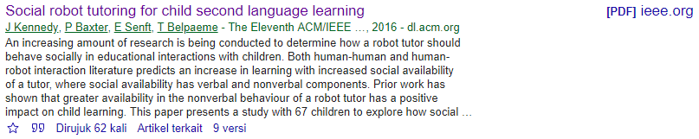
Paper searching (1) J Kennedy et al., “Social Robot Tutoring for Child Second Language Learning,” The Eleventh ACM/IEEE International Conference on Human Robot Interaction, pages 231-238.

Slide 4
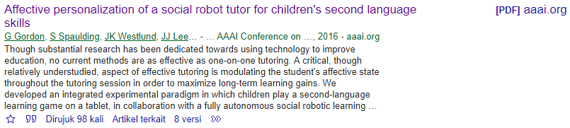
Paper searching (2) G Gordon et al, “Affective Personalization of a Social Robot Tutor for Children’s Second Language Skills,” Proceedings of the Thirtieth AAAI Conference on Artificial Intelligence (AAAI-16).

Slide 5

Paper searching (3) K-Y Chin et al, “Impact of Using an Educational Robot-Based Learning System on Students’ Motivation in Elementary Education,” IEEE Transactions on Learning Technologies, vol. 7 , issue 4, pages 333 - 345.

Slide 6
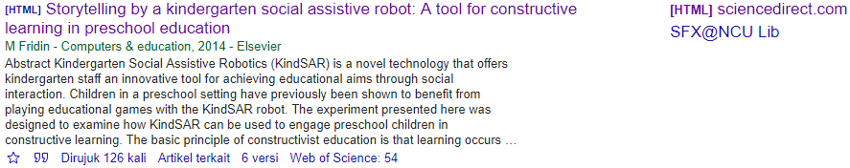
Paper searching (4) M Fridin, “Storytelling by a kindergarten social assistive robot: A tool for constructive learning in preschool education,” Computers & Education, vol. 70, pages 53 – 64.

Slide 7
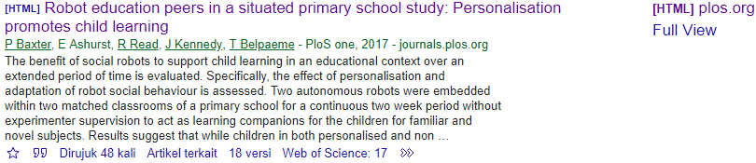
Paper searching (5) P Baxter et al, “Robot education peers in a situated primary school study: Personalisation promotes child learning,” Public Library of Science (PLoS Journal) One 12.5 (2017).

Slide 8
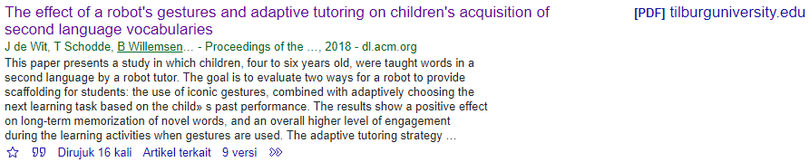
Paper searching (6) A Sullivan, MU Bers, “Dancing robots: integrating art, music, and robotics in Singapore’s early childhood centers,” International Journal of Technology and Design Education, vol. 28, issue 2, page 325 – 346.

Slide 9
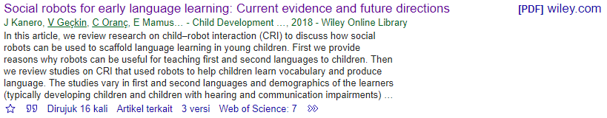
Paper searching (7) J Kanero et al, “Social Robots for Early Language Learning: Current Evidence and Future Directions,” Child Development Perspectives, vol. 12, issue 3, pages 146 – 151.

Slide 10
Paper Writing Progress
1) Discuss with prof Tsai:
About conference specified and prof Tsai’s name position at paper, is up to HCI&Learning Lab.
2) Discuss with Mahesh:
We have plan to submit it to IEEE as soon as possible. So I’m looking for IEEE conference that Last Date of Submission in this year and Conference Dates in early up to middle year of 2020.
Target Place of conference: Asia region.

Slide 11
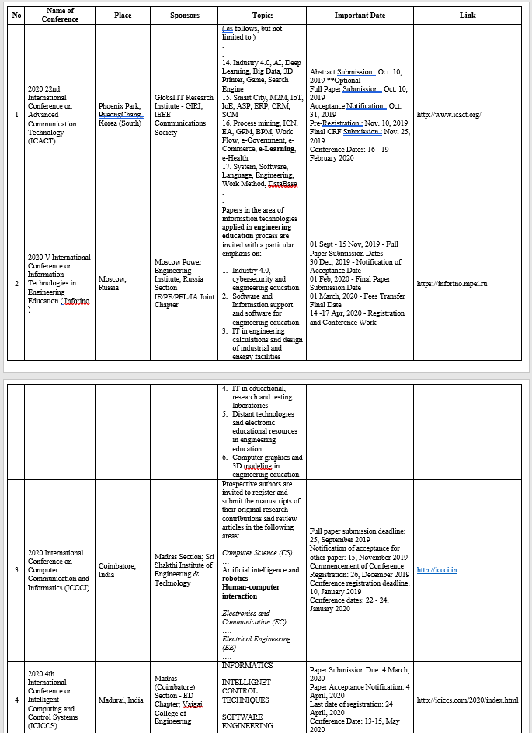
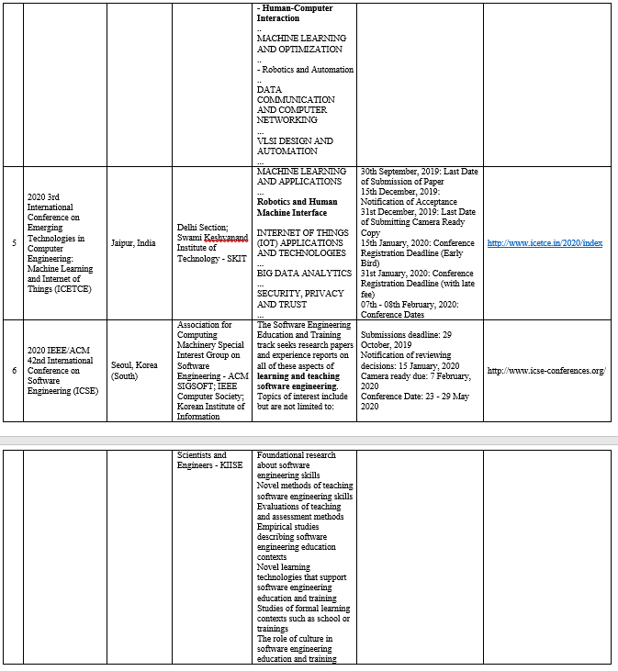
Conference Survey
ACM, IEEE, IOP, AAAI
Keyword: robot, education, learning, humanrobotinteraction, social impacts, e-learning

Slide 12
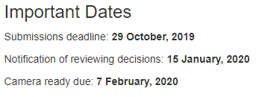

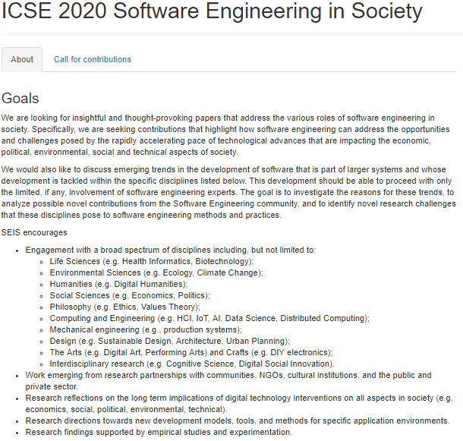
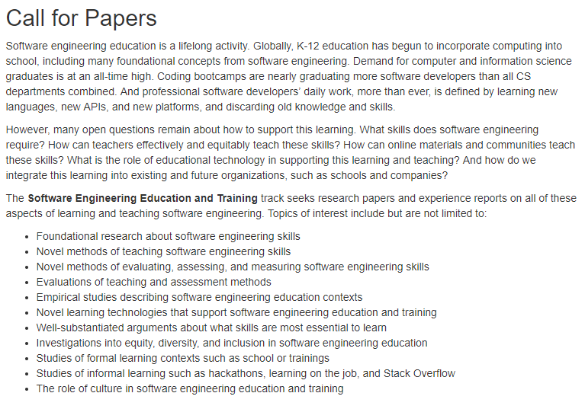
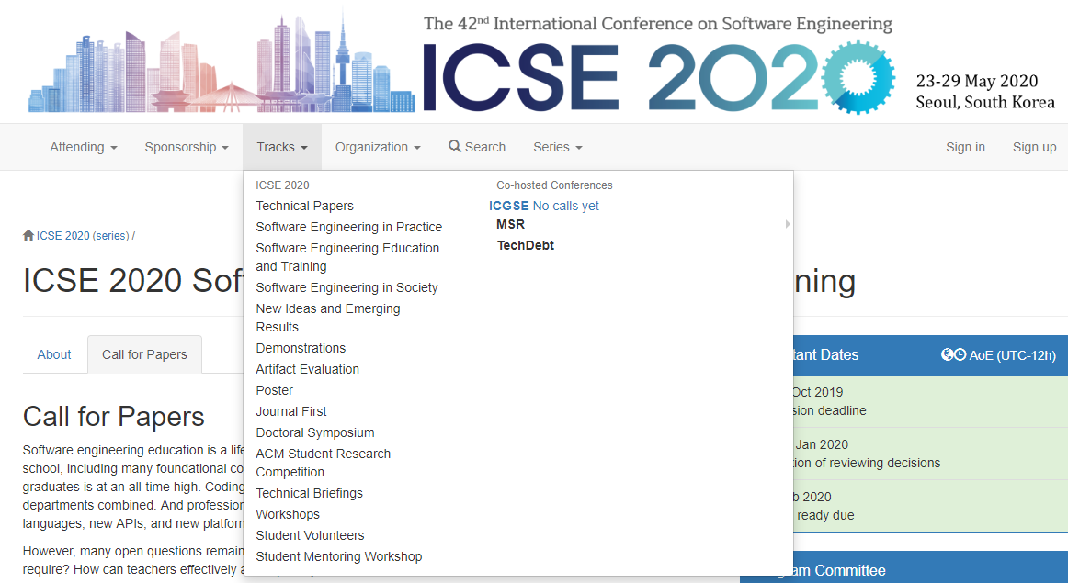
Result of Conference Survey

Slide 13
Thank you

